Slide 1
FMECA:
Failure Modes, Effects, and Criticality Analysis
Ref: ECSS-Q-30-02A – 7 Sept, 2001

Slide 2
Lecture Overview
What is FMECA, Really?
  Definitions
  Types of FMECA and Coverage
FMECA Chronology and Activities
Design FMECA Implementation
  Quantifying DFMECA Criteria
  Detailed Steps in a DFMECA
    Standard FMECA form and contents of each field
Process FMECA Implementation
  Quantifying FMECA Criteria
  Quick Overview of Steps

Slide 3
What is FMECA, Really?
A set of systemized group activities intended to:
  recognize and evaluate the potential failure of a product or process and its effects
  identify and prioritize actions which could eliminate or reduce the chance of the failure occurring
  document the process,
    demonstrate “all due care”
    record the reasoning of the engineers doing the design
It involves:
  Brainstorming to identify “all” potential failure causes
  Assigning numerical priorities to all modes
  Tracking and documenting corrective actions

Slide 4
Definitions
Failure Mode =
  Incorrect behavior of a subsystem or component due to a physical or procedural malfunction
Effect =
  Incorrect behavior of the system caused by a failure
Criticality = The combined impact of
  The probability that a failure will occur
  The severity of its effect

Slide 5
Various Industry Standards
FMEA/FMECA show up in many industries
Different Industries have different standards
  All are very similar in philosophy and procedures
  They vary mostly in product-specific details
Examples:
  SAE Standard: J-1739 (Automotive Systems)
  SAE Standard: ARP-5580 (Non-Automotive Systems)
  Military Standard: MIL-STD-1629A (cancelled)
  ESA: ECSS-Q-30-02A

Slide 6
Types of FMECA and Coverage
DFMECA = Design FMECA:
  Functional DFMECA
  Hardware DFMECA
  HSIA: Hardware Software Inateraction Analysis
PFMECA = Process FMECA

Slide 7
Types of FMECA and Coverage
DFMECA = Design FMECA:
  An analysis of the system’s technical design
  To evaluate the risks of system malfunction in operation.
  DFMECA Process
    assumes the product is correctly fabricated to the design specification,
    still must consider manufacturing capabilities, limitations, and tolerances,

Slide 8
Parts of DFMECA
  Functional FMECA:
    System/Subsystem Functions are analyzed, rather than their implementations
    Evaluates risks that the function is not specified correctly or completely
  Hardware FMECA:
    Hardware implementations of the functions are analyzed
    Evaluates risks that the hardware incorrectly implements its functional specification
  HSIA = Hardware-Software Interaction Analysis:
    Verification that software can tolerate all required hardware failures
    Could be called “Defensive Programming”

Slide 9
Types of FMECA and Coverage
PFMECA = Process FMECA
  An analysis of the system’s Implementation Process
  To evaluate the risks to successful project completion
    Manufacturing, Testing, Supply, Schedule, Budget, etc
  PFMECA process
    assumes the product was correctly specified
    assumes the design is compatible with manufacturing capabilities limitations and tolerances
    is of necessity less quantitative than DFMECA

Slide 10
FMECA Chronology
Start as early as possible (feasibility phase)
  Start with System-Level FMECA
    Define all system-level functions required from subsystems
    Functional FMECA on visible subsystem functions
    Pass these down to subsystem design teams
  Then do Subsystem-level FMECAs
    Functional FMECA on internal subsystem functions
    Hardware FMECA on internal subsystem hardware
    HSIA on subsystem-internal software
  Pass results back up to system level
  Keep PFMECA going along with DFMECA
Iterate, iterate, iterate

Slide 11
FMECA Activities
Step 1: Assemble a Team
  One “Responsible Engineer” needs to be in-charge
    RM Team Leader – system-level FMECA
    Subsystem RM Liaison – susbsystem-level FMECA
  All relevant stake holders need to be involved, e.g.
    Subsystem Teams (Design, Manufacturing, Testing)
    Acquisition, Purchasing
    Customers
      NASA, obviously – at least in a reactive mode
      The next higher-level assembly or system
      Other “client” subsystems that rely on this subsystem
  Limit team to 6 – 10 people

Slide 12
FMECA Activities
Step 2: Do some Brainstorming
  Goal: get “all” potential failure modes on the table
  Questions and ideas should be encouraged
  Do not criticize, analyze, or evaluate comments & ideas
    this is a data growth phase
    the data reduction phase comes later
  Creative and associative thinking should be stimulated
  Get all ideas written down
Step 3: Do your Homework
  get data needed to evaluate all ideas
  histories, testing, analyses, simulations, vendor stats…

Slide 13
FMECA Activities
Step 4: Evaluate & Rank Potential Failure Modes
  use all available information
  assign numerical priority values to all failure modes
    Lots more to come on how this is done
Step 5: Develop an Action Plan
  Define actions to correct the problems identified
  Assign responsibility for each action
  Follow up
    document all corrective actions
    re-evaluate the priorities after corrective action
Step 6: Keep on Iterating – as the product progresses

Slide 14
Quantifying FMECA Criteria
Two Criteria are evaluated for each failure mode:
  SN = Severity Number:
    quanitifies the severity of the effect, given that the failure mode occurs
  PN = Probability Number:
    quanitifies probability that the failure mode occurs
Each Criterion is ranked on a [1 ...4] scale
  4 = worst
  Each ranking level has a detailed verbal description
    makes it difficult to completely misrepresent a threat
    minimizes the impact of “judgement” on numerical value

Slide 15
Quantifying FMECA Criteria
Assigning Priorities to Failures and Effects
  CN = Criticality Number
  CN ≡ SN x PN
  CN ∈ [1…16]
Higher CNs represent higher risks
  Corrective actions are prioritized (highest CNs first)
    Redesign to Change SN
    Redesign to Change PN

Slide 16
Severity
Assesses seriousness of the effects of a failure mode
  Need to have derived effects for failure modes
  If a failure mode has >1 effect, rank it by its worst effect
DFMECA Severity Notation
  1..4 = severity level
  “S” appended = safety-critical (e.g. 1S, 2S)
  “R” appended = protected by redundancy (e.g 1R, 1SR)
Severity can be changed only by a design change

Slide 17
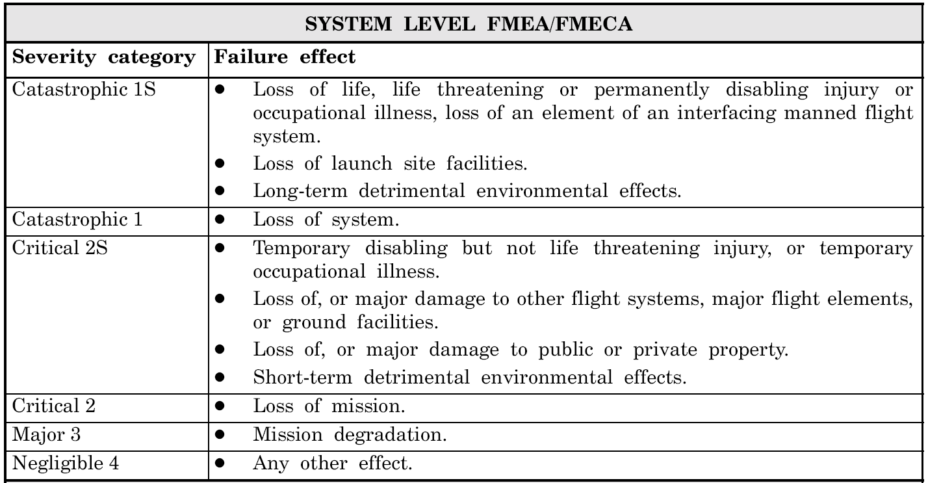
System-Level Severity (Table 1)

Slide 18
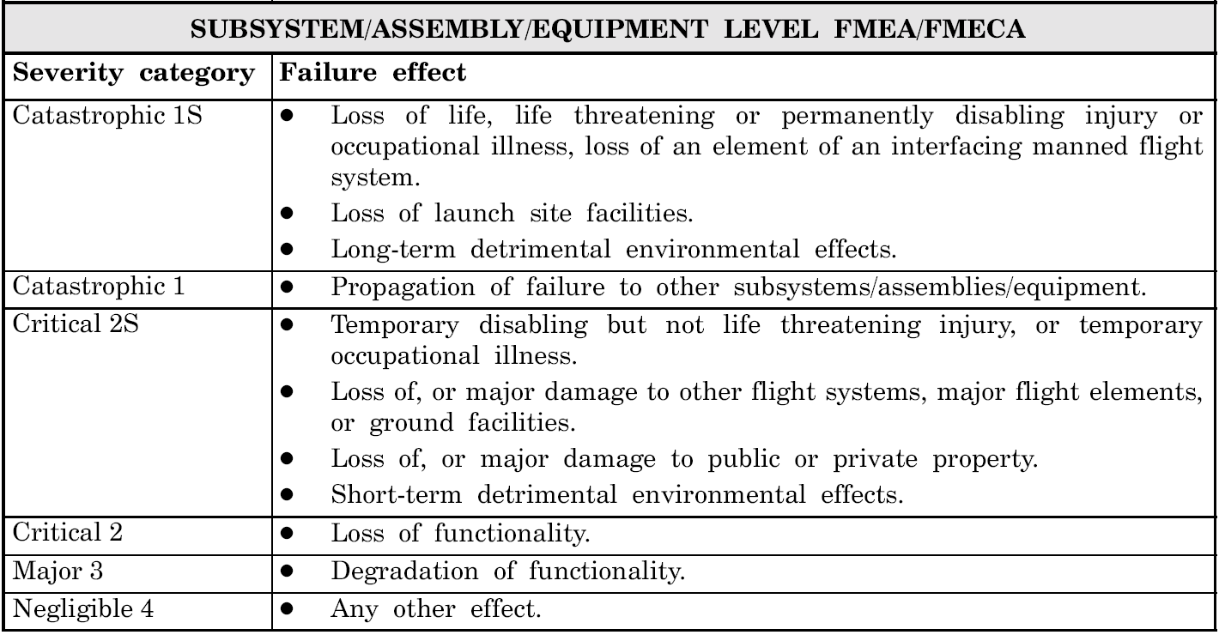
Subsystem-Level Severity (Table 1)

Slide 19
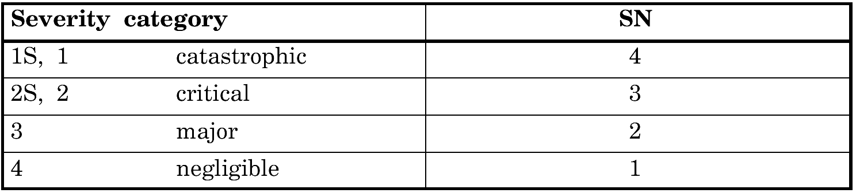
Mapping Severity to SN (Table 2)
Each level is assigned a SN
  Appended S & R notation do not affect SN

Slide 20
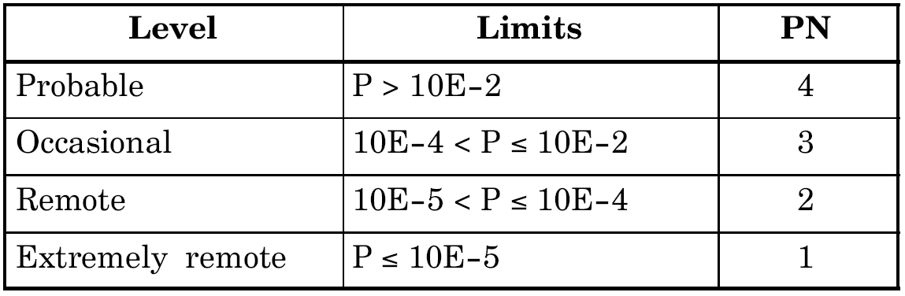
Mapping Probability to PN (Table 3)
Assesses likelihood that the failure mode will occur
  over the “design life of the product”
  tries to define it as a probability range
  Here’s where redundancy “R” has an impact

Slide 21
Design FMECA Worksheet
The ESA Spec gives 2 DFMECA options
  Figure 2 = Landscape Format (Spreadsheet friendly)
  Gigure 3 = Portrait Format (Easier to read)
Header Blocks = traceability data
  Essential to have a uniform document tracking system
  Need to know who decided what, and when
  Must be able to backtrack to the document later on
    To link to To document remediation of risks
    To permit updating and upgrading of FMECA
    To provide support later FMECA during integration

Slide 22
FMECA Worksheet
1. Ident. Number
  invent a unique numbering scheme to ID each failure mode analyzed
2. Item/Block
  Indicate Component, Subsystem, or Function
  Block ID from a Reliability Block Diagram (RBD)
    We won’t use RBDs
    Fault-Trees can do anything they can do
3. Function
  Briefly, what is the item supposed to do

Slide 23
Detailed DFMECA Steps
4. Failure Mode
  Here’s where the brainstorming pays off
  Draw on all resources that indicate how it can fail
    histories, complaints, test data, analyses, simulations, ...
  Remember to include
    complete failures
    partial failures
    intermittent failures
  Use physical and technical terms
    short circuit, open circuit, high-Z, stuck-at-one, ...
    not the symptoms noticed by the client or system

Slide 24
Detailed DFMECA Steps
5. Failure Cause
  List every conceivable cause and/or mechanism
  Look for root causes
  List each as a separate line item
  Example Causes
    EM interference, vibration, foreign material
  Example Mechanisms
    corrosion, wear, creep, insulation aging
  Guess what: more brainstorming!

Slide 25
Detailed DFMECA Steps
6. Mission Phase / Operational Mode
  List mission phases affected
  At least the phase resulting in the most severe effects

Slide 26
Detailed DFMECA Steps
7. Failure Effects
  (a) Local effects on the item/function itself
  (b) End effects seen by other items/functions
    May not be apparent until later phases of design
  Describe effects in terms of:
    deviations from expected system performance
    symptoms that a client may experience or notice
  Remember to include effects on all clients
    The next higher-level assembly or system
    Other systems that rely on this product
  Do More Brainstorming

Slide 27
Detailed DFMECA Steps
8. Severity Classification
  From Table 1
9. Failure detection methods – Observable symptoms
  All means by which this failure mode can be detected
10. Compensating Provisions
  All existing methods to mitigate the effect of the failure
  Include:
    (a) design provisions (redundancy, fault containment)
    (b) operator action (including recovery afterwards)

Slide 28
Detailed DFMECA Steps
11. Severity Number (SN)
  from Table 2
12. Failure probability and Probability Number (PN)
  From Table 3
  Uncertainty in this number will be high early on
13. Criticality Number (CN)
  = SN x PN

Slide 29
Detailed DFMECA Steps
14. Corrective Actions
  Specify conditions for “acceptance” of the risk
  List actions needed to lower the CN of the item
  When specifying actions, there are two options
    Reducing Probability Number
    Reducing Severity Number
  If no actions are recommended, write down “none”
15. Remarks – random comments

Slide 30
HSIA Implementation
Identifies Hardware faults relevant to software execution
Tracks software response and tolerance of those faults
Ensures we have thought about the problem
Figure 6 = HSIA Table
Table 5 = HSIA checklist

Slide 31
Process FMECA
Assesses failures of the design process
Three Criteria are evaluated for each failure mode:
  SN = Severity Number:
    quanitifies the severity of the effect, given that the failure mode occurs in the design process
  PN = Probability Number:
    quanitifies probability that the failure mode occurs
  DN = Detection Number:
    Quantifies probability that the failure mode will be detected by the design process

Slide 32
Process FMECA
Each Criterion is ranked on a [1 ...4] scale
  4 = worst
  Each ranking level has a detailed verbal description
    makes it difficult to completely misrepresent a threat
    minimizes the impact of “judgment” on numerical value
  More judgment & fewer hard numbers than DFMECA
Criticality Number (CN)
  CN = SN x PN x DN
  CD ∈ [1… 64]

Slide 33
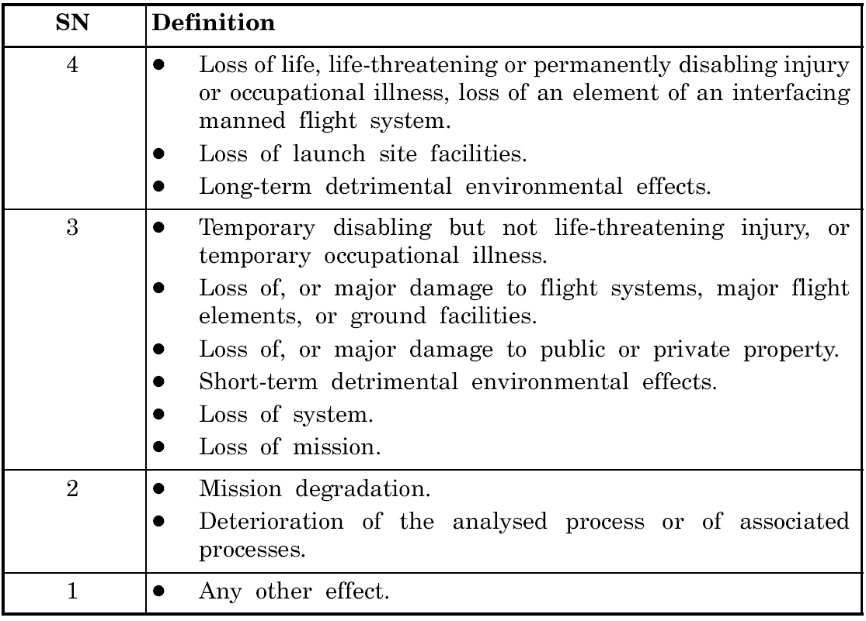
PFMECA SNs

Slide 34
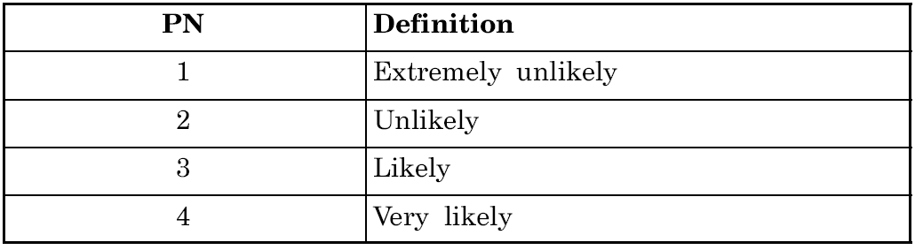
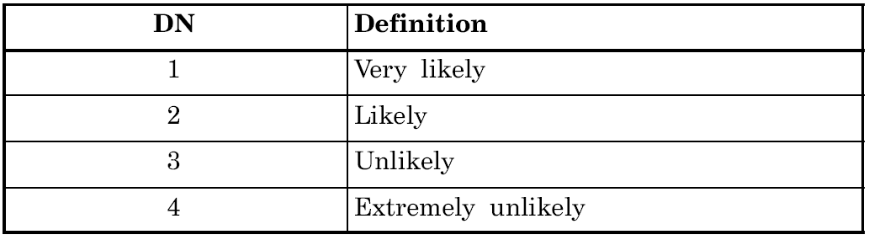
PFMECA PNs and DNs

Slide 35
Summary
FMECA:
  Is a formalized group-based problem solving method
    Similar to design review standards in many industries
    Uses brainstorming to try to identify “all” risks
  Has become an industry-standard approach
    Is revised and improved based on experience
    Attempts to define a general “best known method”
  Tries to accomplish the following:
    Identify risks
    Prioritize them
    Define and track corrective actions and their effects
    Document the entire decision process

Slide 36
Summary
The bottom line is accountability:
  You can seldom say “We made the correct decision”
    There are too many conflicting criteria
    Not all criteria can be precisely quanitfied
    Not all events can be predicted
  But you can say “We made the decision correctly”
    We complied with industry standards in good faith
    We used the “best known methods”
    We exercised “all due care”
    We documented the decisions and the process
      For backtracking in case of a failure
      To allow for process improvements in the future

